Slide 1
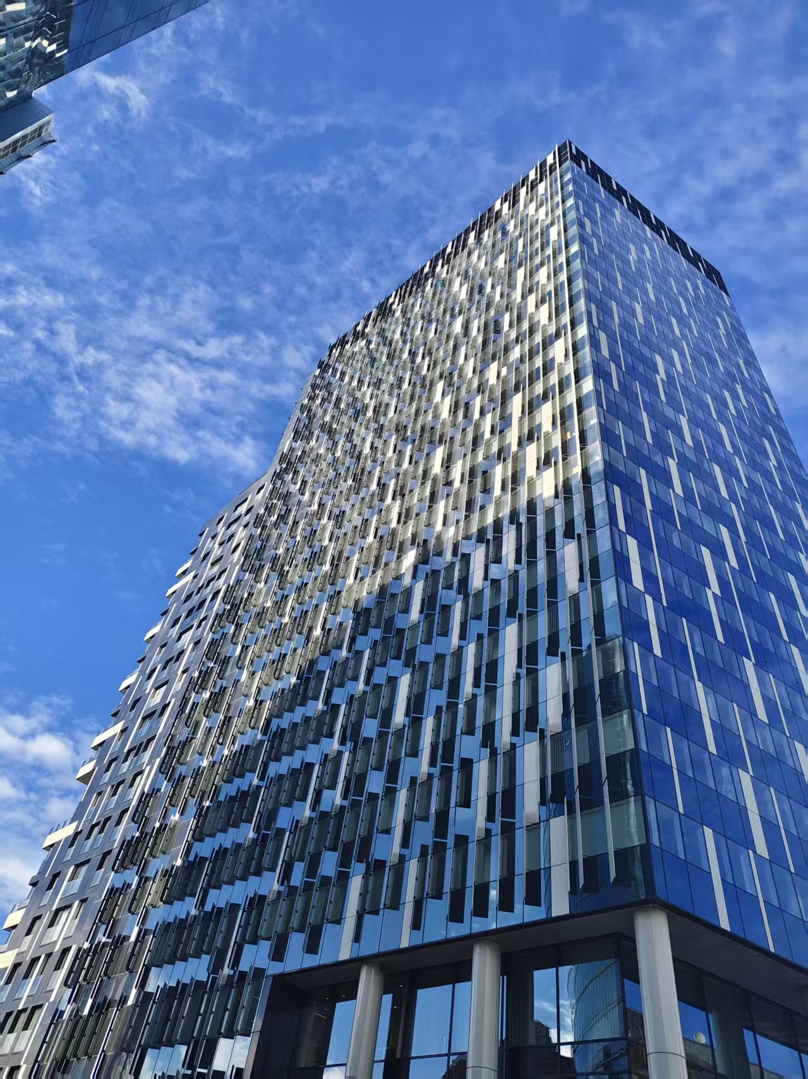
Behind the Papers:
Human Rights Work in Times of Crisis
Why this topic?
How do human rights mechanisms actually operate in practice, not before the courts, but in real life?
Speaker: Shenfei Zhou

Slide 2
1
2 examples from internship
CONTENTS
2
The Crisis
3
The Reflections

Slide 3
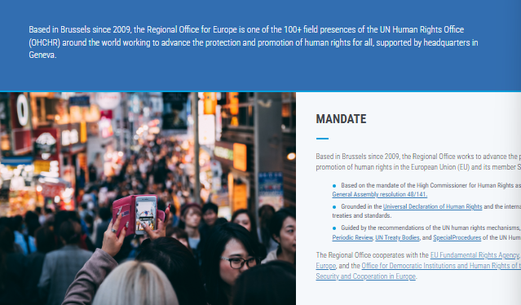
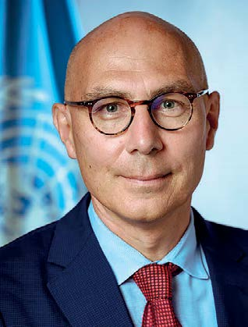
A small office, diverse tasks
The Office of the High Commissioner for Human Rights (OHCHR)
Regional Office for Europe (ROE)
Mr. Volker Türk
The High Commissioner (HC)
Harder ones –
GLO: Global Operations Division
LOIPR: list of issues prior to the reporting

Slide 4
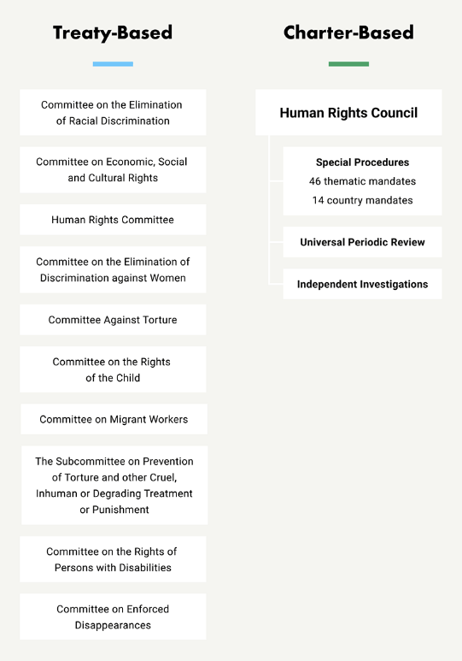
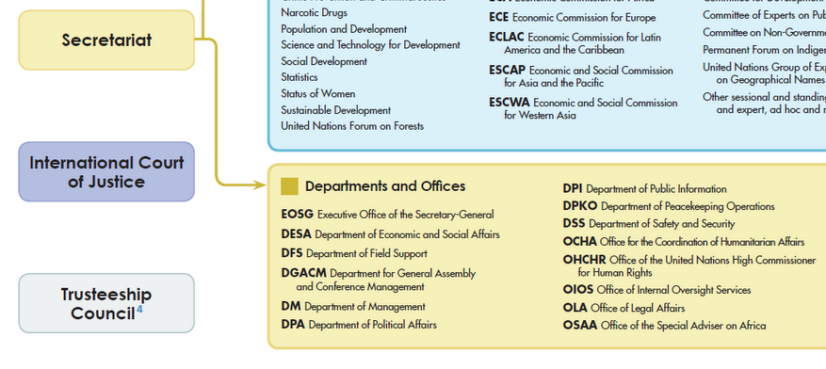
A small office, diverse tasks
Two types of human rights monitoring mechanisms within the United Nations system: treaty-based bodies and charter-based bodies.
OHCHR provides expertise and support to all of the different mechanisms.

Slide 5

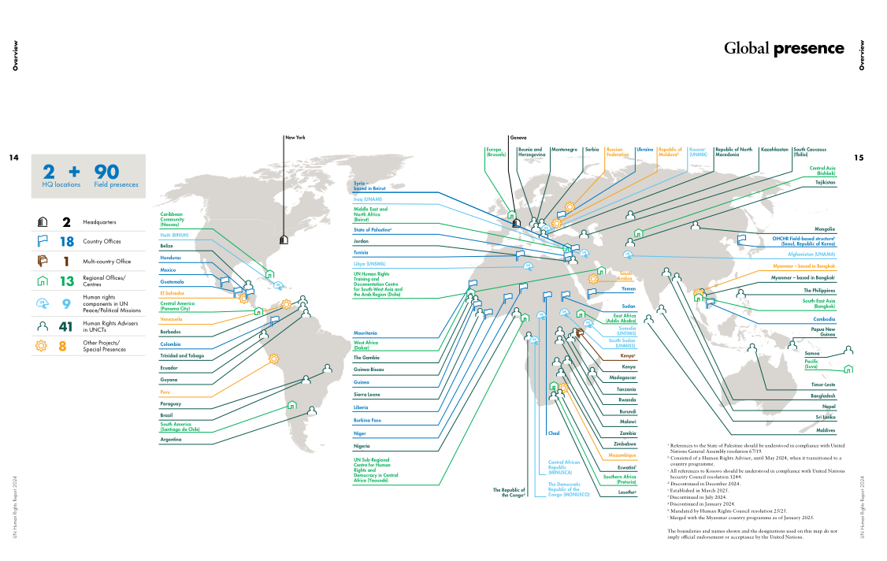
A small office, diverse tasks
* 2 HQ + 90 field presences
* My task

Slide 6
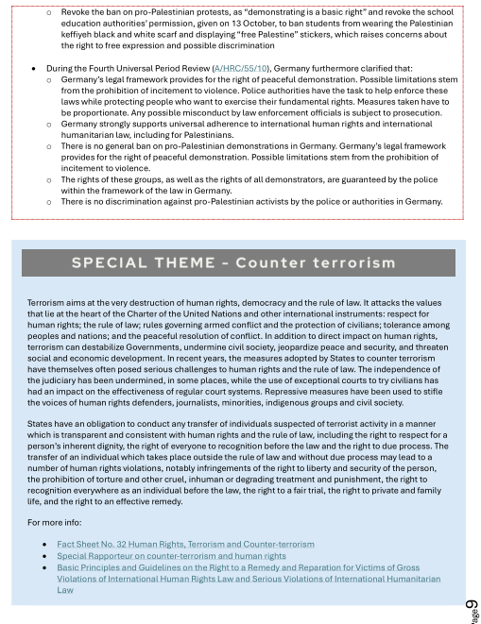
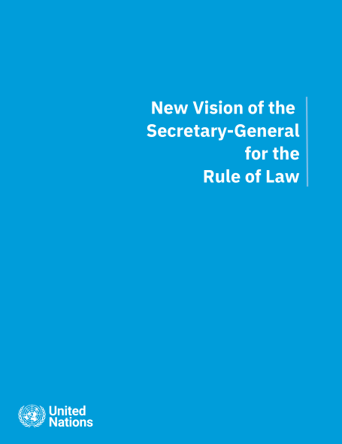
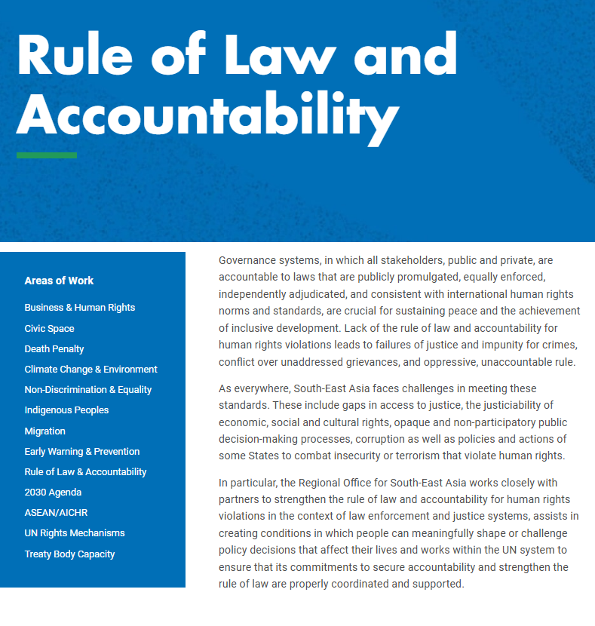
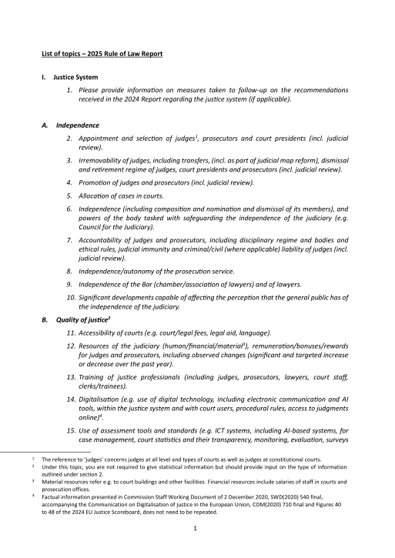
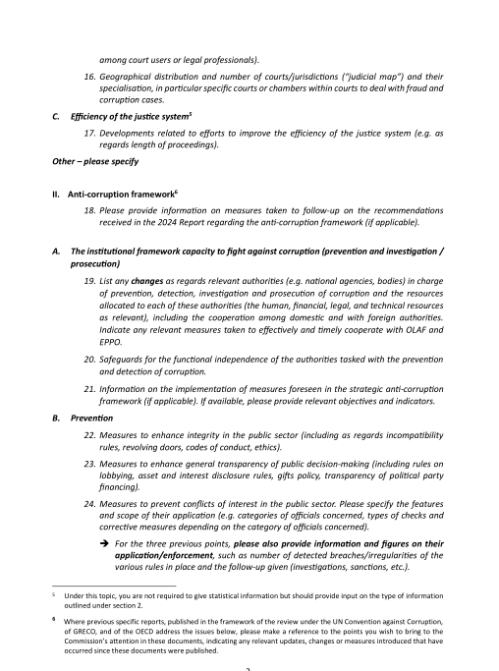
Case 1 Fitting human rights into institutional formats
EU Rule of Law report
Justice System (…child justice, transitional justice)
Four Pillars
Justice System (independence & resources)
Anti-Corruption
Media Freedom
Checks and Balances
* Final contribution to the EU Rule of law report
* Rule of law in EU
* Rule of law in UN

Slide 7
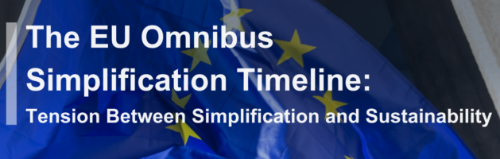
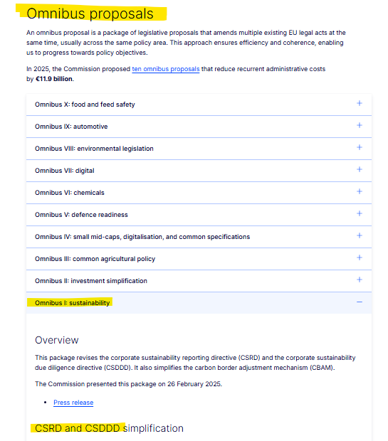
Case 2 Keeping human rights visible in real time (business and human rights)
Omnibus I package - Commission simplifies rules on sustainability and EU investments, delivering over €6 billion in administrative relief.
CSDDD: Corporate Sustainability Due Diligence Directive
CSRD: Corporate Sustainability Reporting Directive
OHCHR (ROE): 1 event, 2 roundtables, 3 press releases, 1 report.

Slide 8

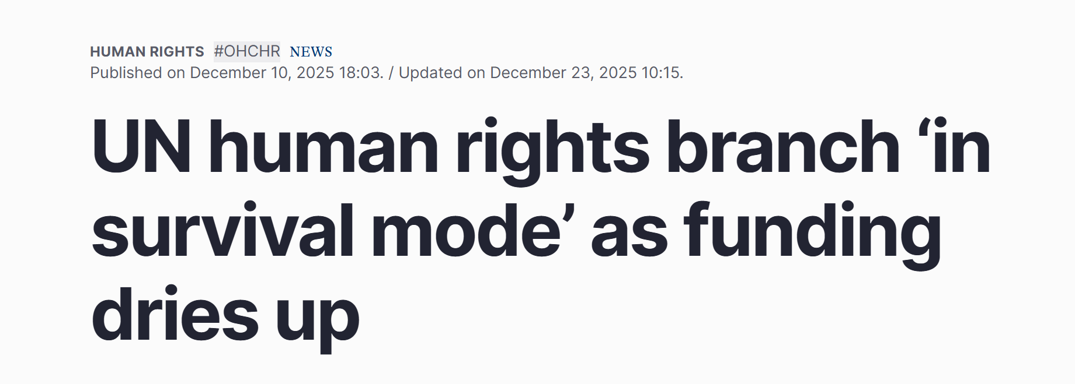
In Time of Crisis
Political Crisis: State to withdraw Human Rights Council, and to quit Universal Periodic Review
-- > Does it create a real problem of legitimacy?
Looking into procedural rules: Decision adopted by the Human Rights Council at its seventh organizational meeting “Non-cooperation of a State under review with the universal periodic review mechanism”(OM/7/101).
Financial Crisis: Funding cuts and lost of posts. More pressure on global south and more unstable contracts.

Slide 9
Back to the title: behind the papers?
Paper-making as process
Not final outcome, but organised discourse.
Documents are “artifacts of modern knowledge”(Riles, 2006).
Translation from “real reality” to “UN reality”
Linking field knowledge and UN discourse, traveling from “particular” and “universal” (Naples-Mitchell, 2011: 233).
Non-normative values
Beyond legal effect
“It is in the micro-processes of human rights discourse, practice and consciousness that its effects become visible” (Merry, 2017:139).

Slide 10
Thank you!

